Slide 1
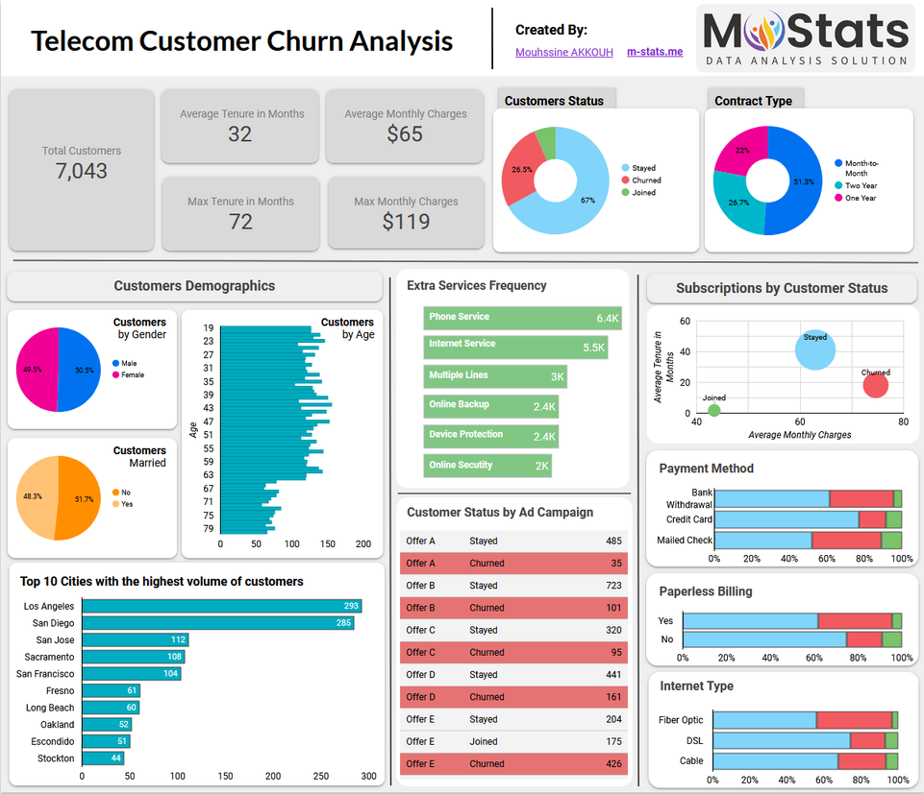

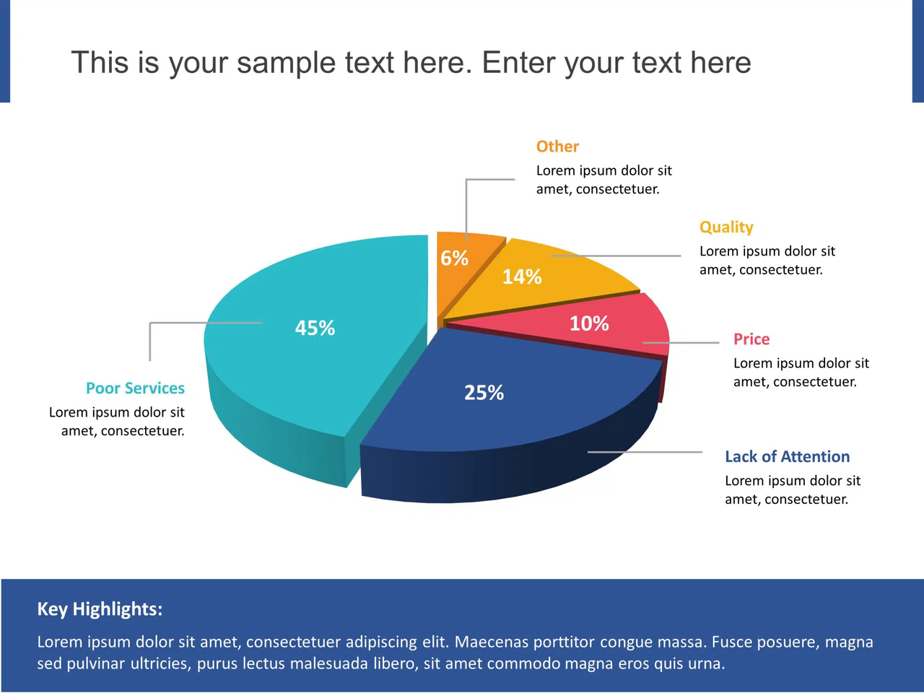

CUSTOMER CHURN PREDICTION FOR TELECOM
A Data-Driven Solution to Predict Customer Retention.
Presented By :- Subhadeep Das
Course / Internship :- IBM / AI&ML
Mentored By :- Himanshu Souda

Slide 2
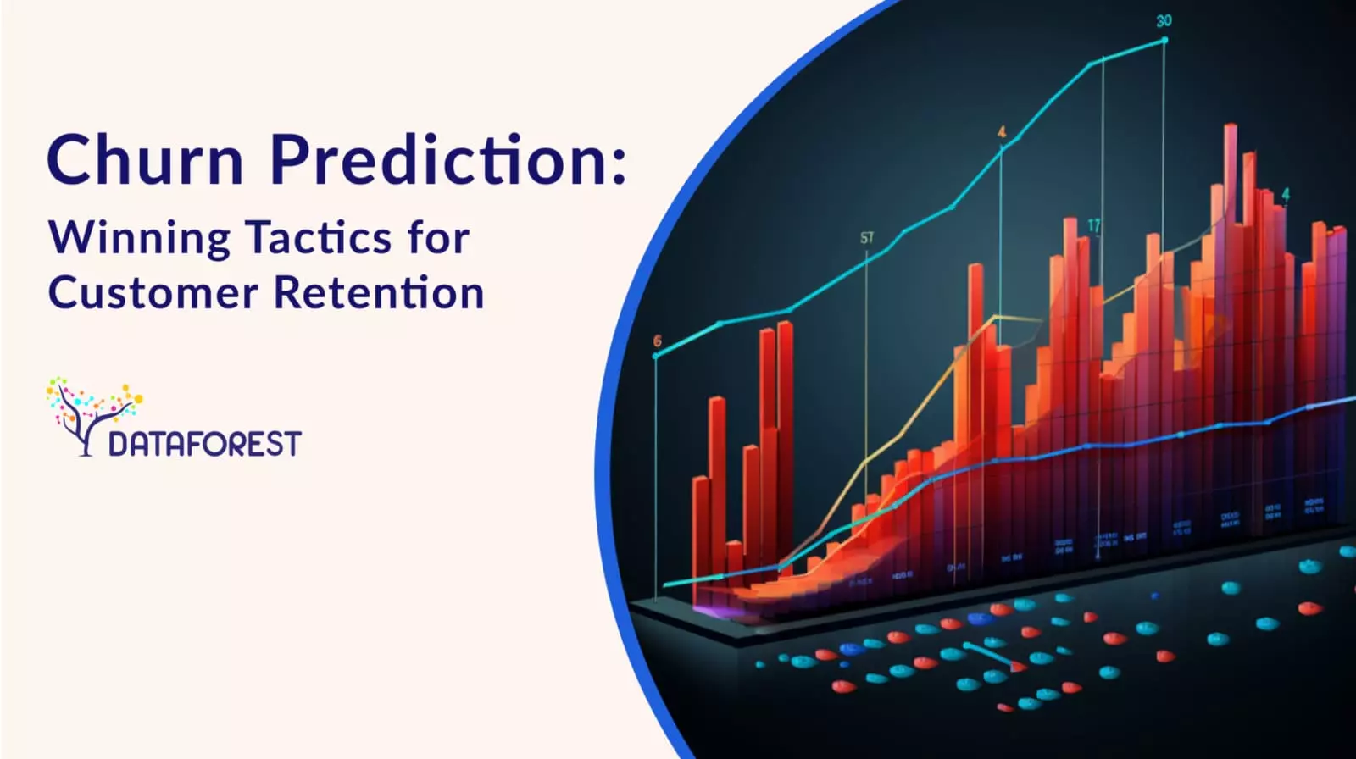
PROBLEM STATEMENT
Telecom companies lose millions every year due to customers switching to competitors. It is difficult to manually analyze which customers will leave based on :
MONTHLY CHARGES
TENURE
CUSTOMER SERVICE CALLS
INTERNET SERVICE
CONTRACT TYPE
PAYMENT METHOD
TOTAL CHARGES, ETC.
Goal:
Predict which customers are at high risk of churn
Help telecom companies take preventive actions in advance.

Slide 3
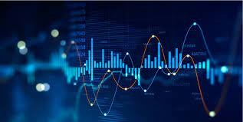
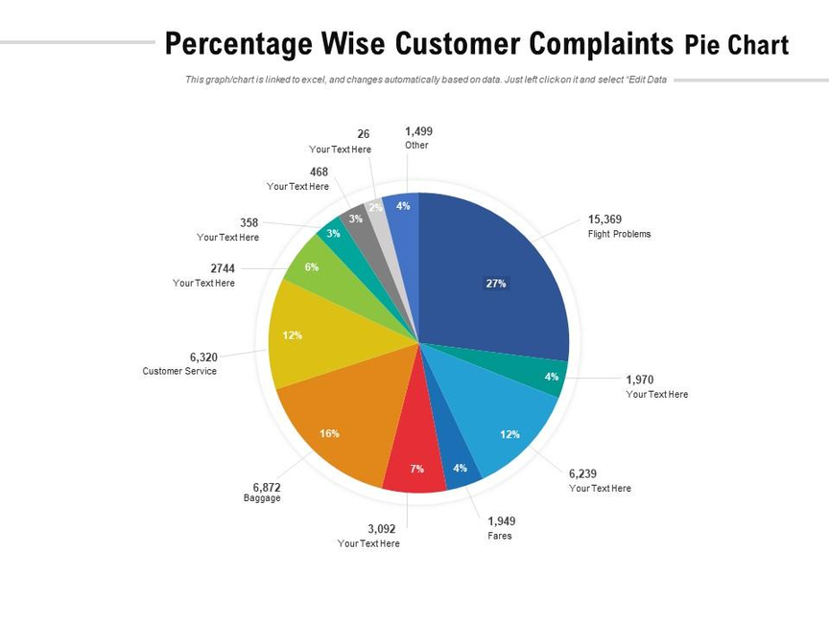
PROJECT DESCRIPTION
This project focuses on building a Machine Learning-based churn prediction system for telecom companies.
The system :
Analyzes customer usage patterns .
Identifies high-churn probability customers .
Helps telecom companies improve customer retention strategies .
Provides data insights, visualizations, and model performance comparison .
The final product includes :
Dataset upload
Multi-model training (Decision Tree, Random
Forest, XGBoost)
Churn prediction screen
Feature importance
Insights tab
Model inspector
Downloadable performance report (CSV)

Slide 4
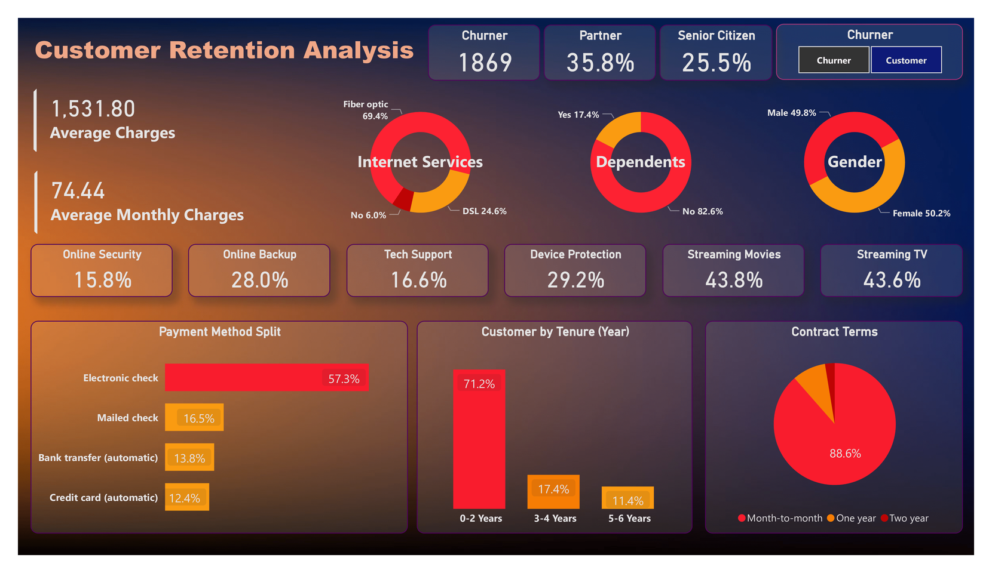
REASON OF CHOOSING THIS PROJECT
I have chosen this project because :-
I
Telecom churn is a real industry problem
Every company wants to retain customers
Predictive analytics is highly useful in this domain
Great combination of Machine Learning + Streamlit UI
Provides hands-on experience with :
Data preprocessing
Feature engineering
Model comparison
Frontend development
Deployment-ready workflow

Slide 5
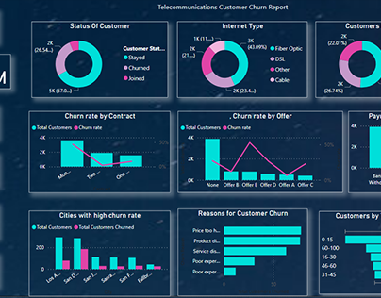
SOLVED PROBLEMS
IDENTIFIES CUSTOMERS LIKELY TO CHURN.
HELPS TELECOM COMPANIES TAKE EARLY ACTION.
REDUCES CUSTOMER LOSS.
IMPROVES BUSINESS DECISION MAKING.
INCREASES REVENUE RETENTION.
HELPS TARGET MARKETING MORE EFFICIENTLY.

Slide 6
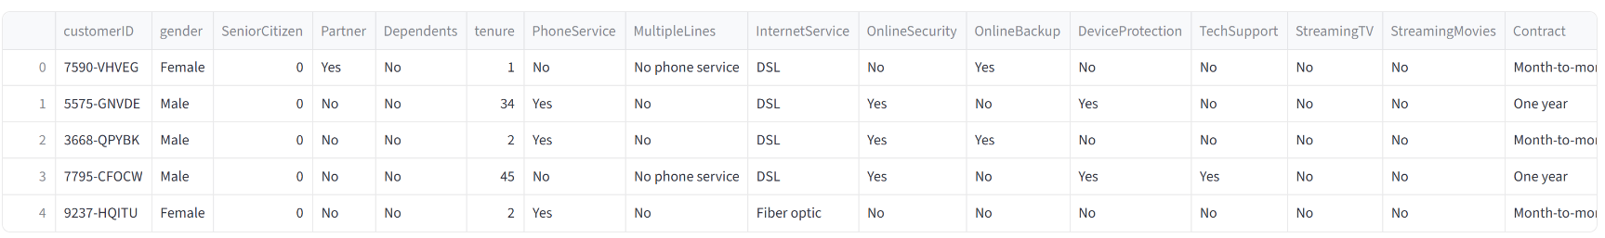
DATASET DESCRIPTION
FEATURES | FEATURES | FEATURES
Gender | Senior Citizen | Tenure
Partner, Dependents | Phone Service | Contract
Partner, Dependents | Internet Service | Multiple Lines
Partner, Dependents | Payment Method | Monthly Charges
Total Charges | Total Charges | Total Charges
Target Variable :- Churn (Yes / No) | Target Variable :- Churn (Yes / No) | Target Variable :- Churn (Yes / No)
Here in this project, i have used the Telco Customer Churn Dataset from Kaggle website which contains features like :-

Slide 7
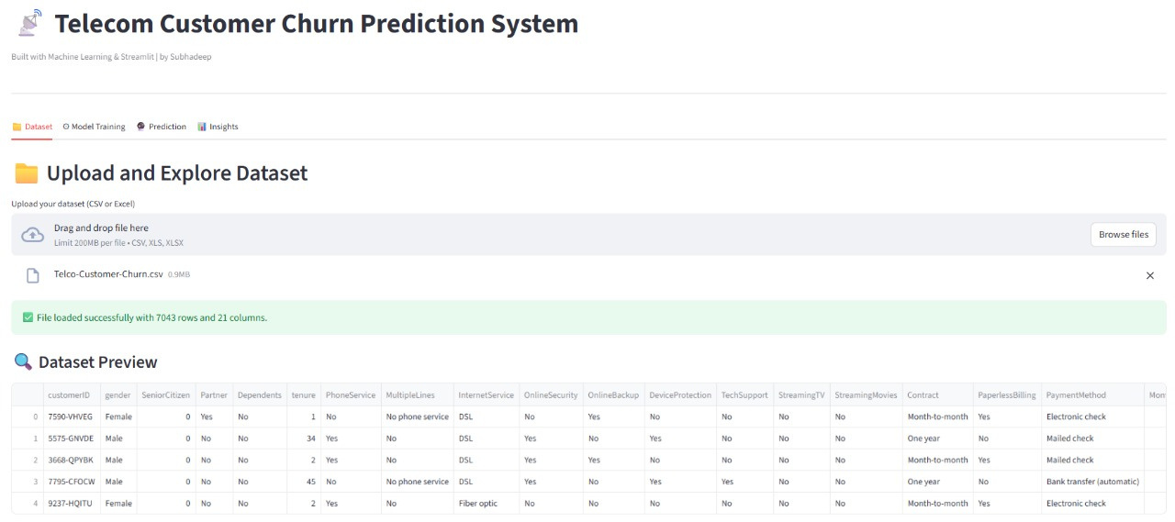
TECH STACK
I have used different teck stack to input the data, train the data by using different machine learning models and visualize the model using the basic frontend development. The used tech stacks are in below :-
LANGUAGES & LIBRARIES | LANGUAGES & LIBRARIES | LANGUAGES & LIBRARIES
Python | Pandas | NumPy
Matplotlib | Seaborn | Scikit-Learn
XGBoost | XGBoost | XGBoost
DEVELOPMENT TOOLS | DEVELOPMENT TOOLS | DEVELOPMENT TOOLS
Google Colab | VS Code | GitHub
Kaggle Dataset | Kaggle Dataset | Kaggle Dataset
FRONTENED UI | FRONTENED UI | FRONTENED UI
Streamlit (For the entire web Interface) | Streamlit (For the entire web Interface) | Streamlit (For the entire web Interface)

Slide 8
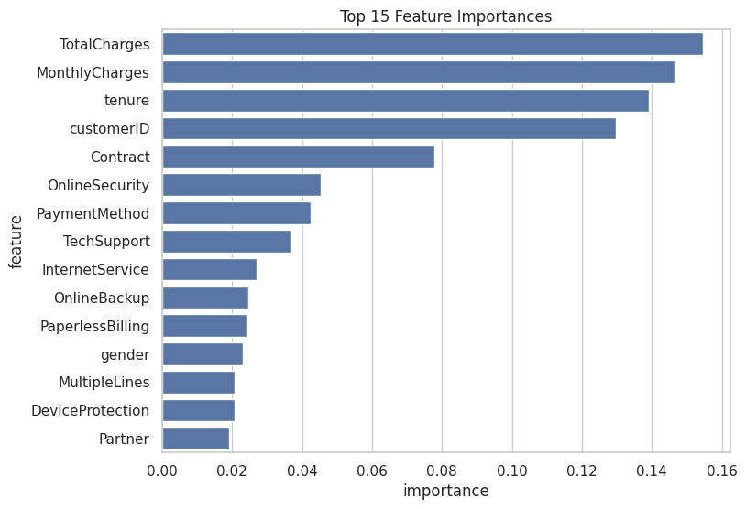
MACHINE LEARNING ALGORITHMS
In this model, i have used the following machine learning algorithms :-
DECISION TREE CLASSIFIER | DECISION TREE CLASSIFIER | DECISION TREE CLASSIFIER
Easy to interpret. | Easy to interpret. | Easy to interpret.
Works well on tabular telecom data. | Works well on tabular telecom data. | Works well on tabular telecom data.
Handles non-linearity. | Handles non-linearity. | Handles non-linearity.
XGBOOST CLASSIFIER | XGBOOST CLASSIFIER | XGBOOST CLASSIFIER
Highly efficient & fast. | Highly efficient & fast. | Highly efficient & fast.
Handles imbalanced data. | Handles imbalanced data. | Handles imbalanced data.
Best accuracy in most telecom churn studies. | Best accuracy in most telecom churn studies. | Best accuracy in most telecom churn studies.
Final best model. | Final best model. | Final best model.
RANDOM FOREST CLASSIFIER | RANDOM FOREST CLASSIFIER | RANDOM FOREST CLASSIFIER
Ensemble of many decision trees. | Ensemble of many decision trees. | Ensemble of many decision trees.
More accurate. | More accurate. | More accurate.
Less overfitting. | Less overfitting. | Less overfitting.
Used as one of the best performers. | Used as one of the best performers. | Used as one of the best performers.

Slide 9
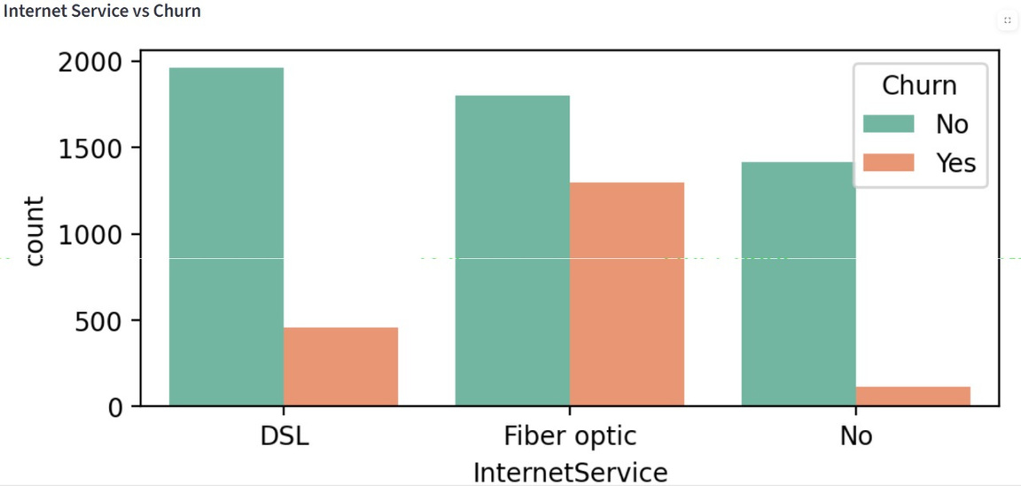
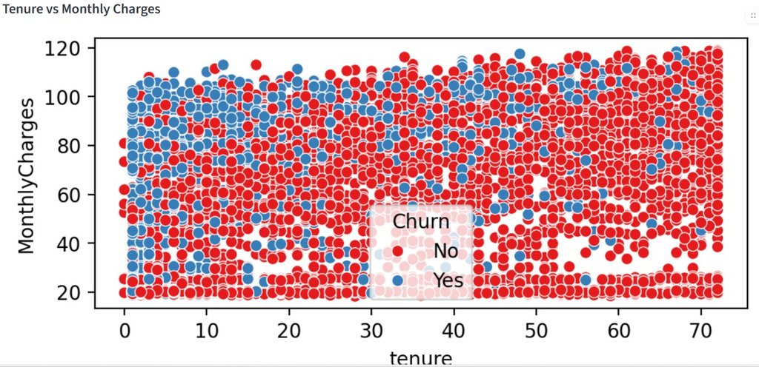
SYSTEM’S WORK-FLOW
Step-By-Step Work-Flow | Step-By-Step Work-Flow | Step-By-Step Work-Flow | Step-By-Step Work-Flow | Step-By-Step Work-Flow
Upload customer dataset | Upload customer dataset | Upload customer dataset | Upload customer dataset | Upload customer dataset
Algorithm training begins | Algorithm training begins | Algorithm training begins | Algorithm training begins | Algorithm training begins
Models evaluated & compared | Models evaluated & compared | Models evaluated & compared | Models evaluated & compared | Models evaluated & compared
Best model selected | Best model selected | Best model selected | Best model selected | Best model selected
User enters customer details | User enters customer details | User enters customer details | User enters customer details | User enters customer details
Prediction generated : 1 ⟶ Churn 0 ⟶ Stay | Prediction generated : 1 ⟶ Churn 0 ⟶ Stay | Prediction generated : 1 ⟶ Churn 0 ⟶ Stay | Prediction generated : 1 ⟶ Churn 0 ⟶ Stay | Prediction generated : 1 ⟶ Churn 0 ⟶ Stay
Model Inspector shows : Feature Importance Model Parameters Accuracy from report | Model Inspector shows : Feature Importance Model Parameters Accuracy from report | Model Inspector shows : Feature Importance Model Parameters Accuracy from report | Model Inspector shows : Feature Importance Model Parameters Accuracy from report | Model Inspector shows : Feature Importance Model Parameters Accuracy from report
Insights tab shows graphs | Insights tab shows graphs | Insights tab shows graphs | Insights tab shows graphs | Insights tab shows graphs

Slide 10
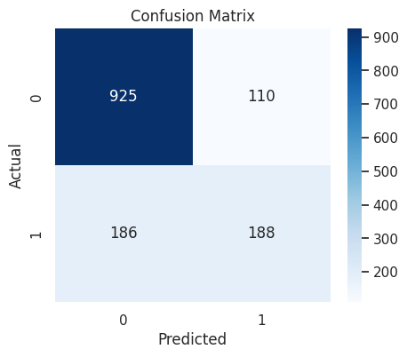
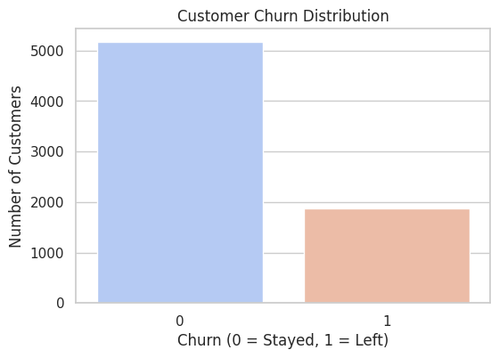
DEMO SCREENSHOTS
GITHUB LINK :- https://github.com/Sayan-0z000/Subhadeep_Das_IBM-Project_Customer_Churn_Prediction_For_Telecom

Slide 11
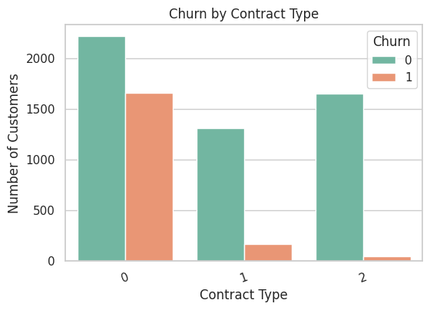
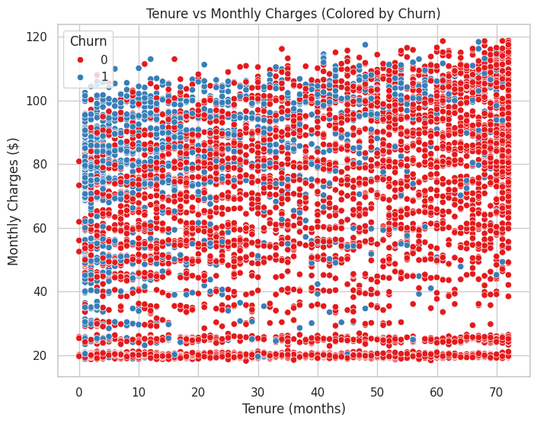
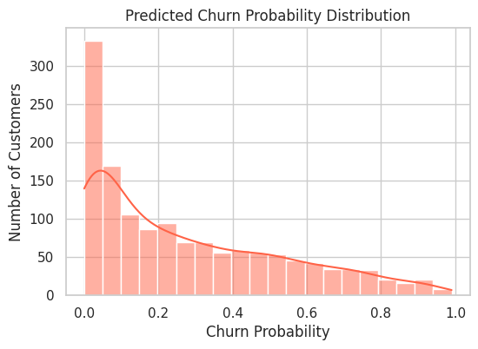
DEMO SCREENSHOTS
GITHUB LINK :- https://github.com/Sayan-0z000/Subhadeep_Das_IBM-Project_Customer_Churn_Prediction_For_Telecom

Slide 12
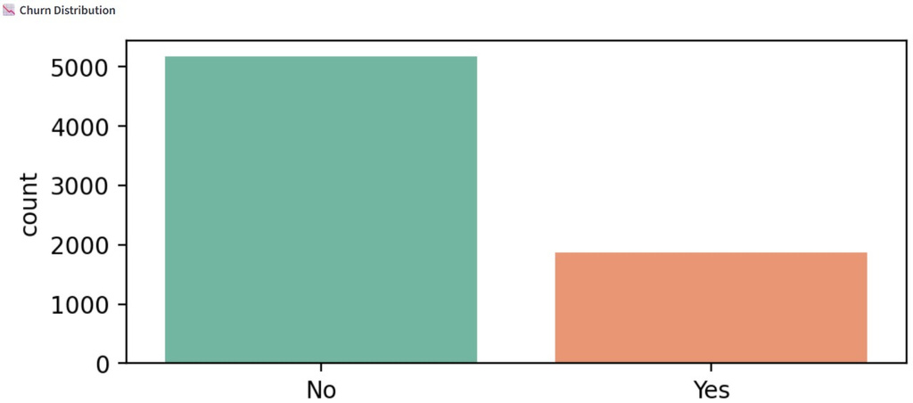
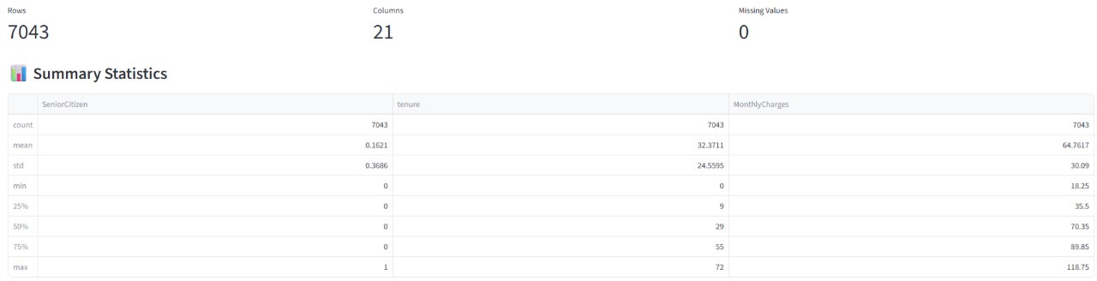
DEMO INTERFACE SCREENSHOTS
GITHUB LINK :- https://github.com/Sayan-0z000/Subhadeep_Das_IBM-Project_Customer_Churn_Prediction_For_Telecom

Slide 13
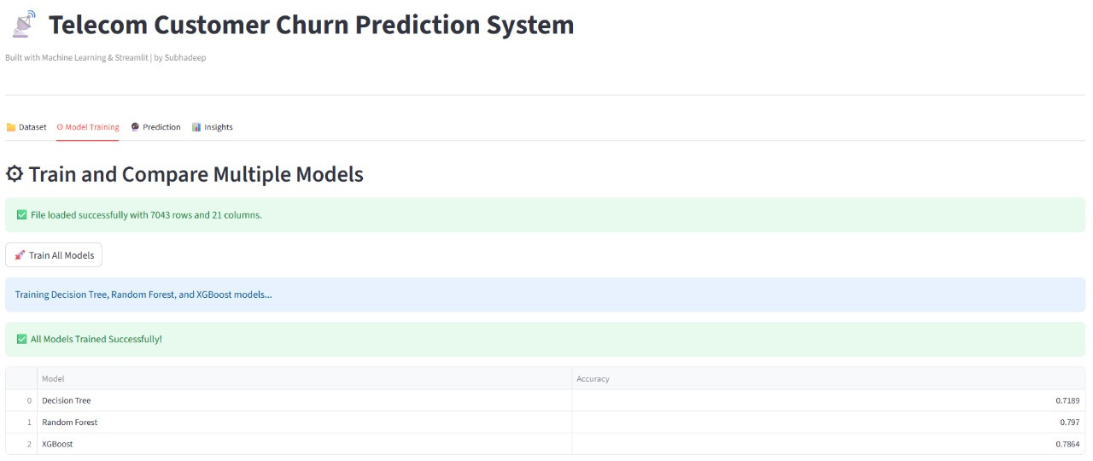
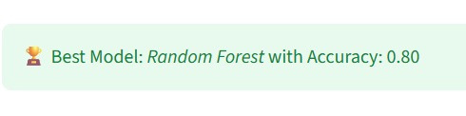
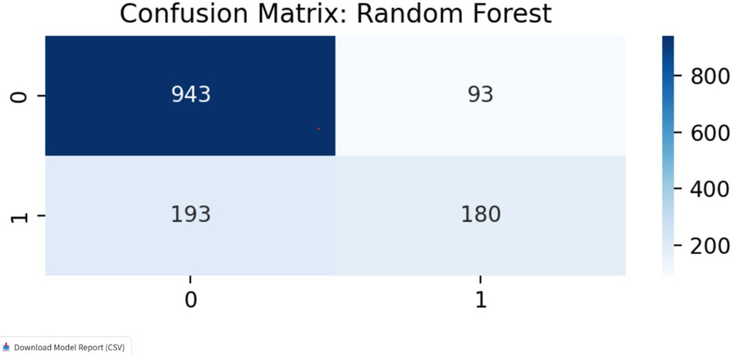
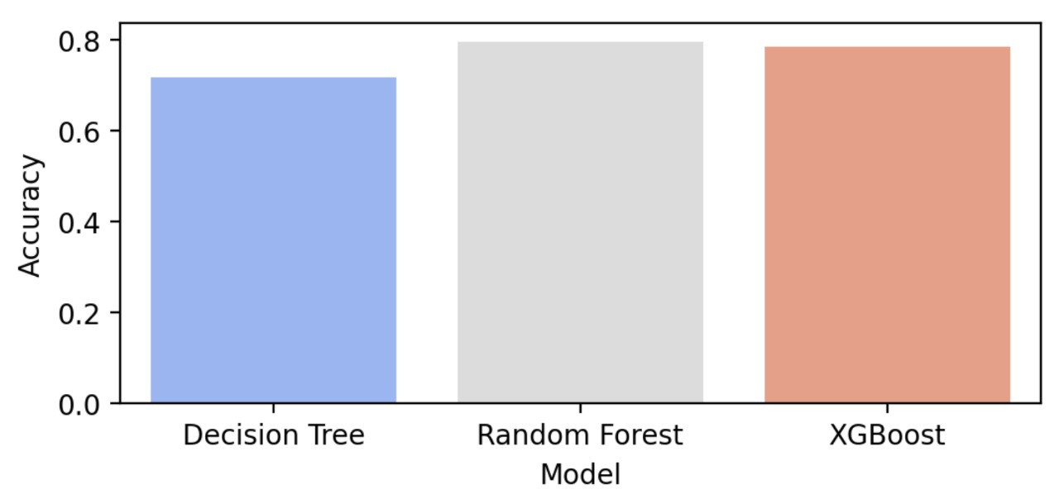
DEMO INTERFACE SCREENSHOTS
GITHUB LINK :- https://github.com/Sayan-0z000/Subhadeep_Das_IBM-Project_Customer_Churn_Prediction_For_Telecom

Slide 14
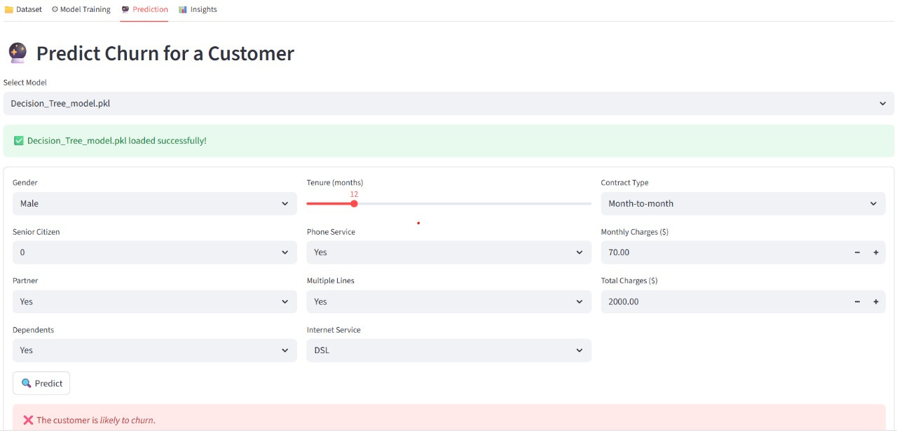
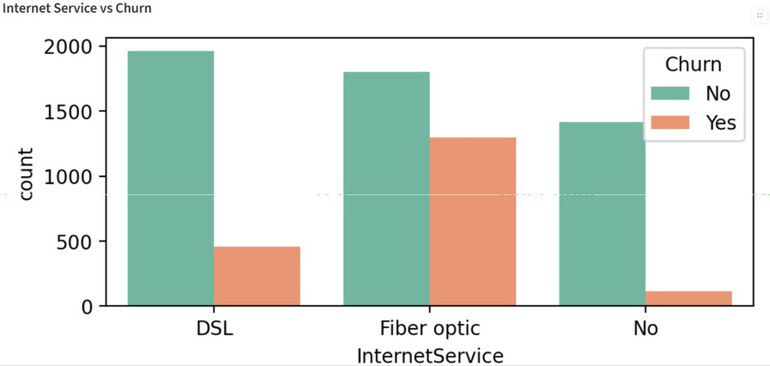

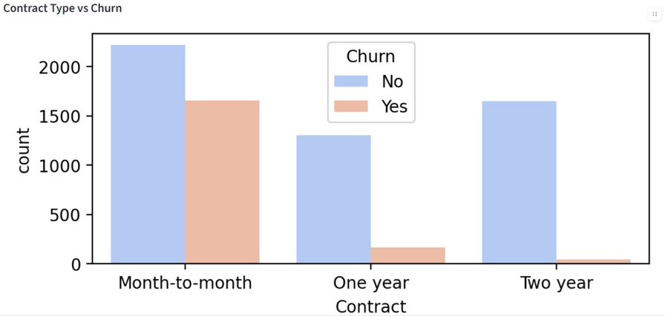
DEMO INTERFACE SCREENSHOTS

Slide 15
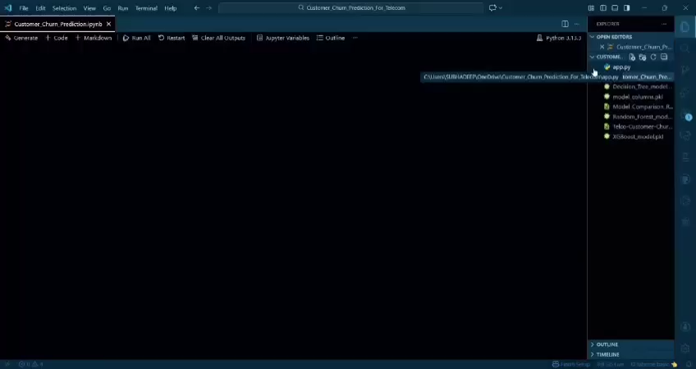
DEMO INTERFACE VIDEO
GITHUB LINK :- https://github.com/Sayan-0z000/Subhadeep_Das_IBM-Project_Customer_Churn_Prediction_For_Telecom

